Slide 1
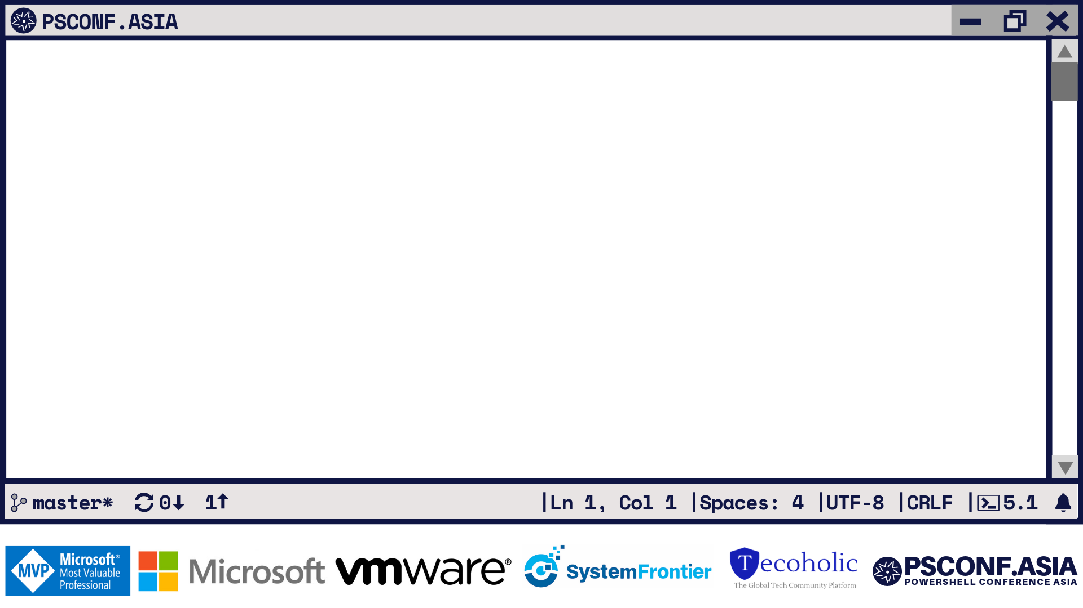
Building Dynamic Interfaces with Universal Dashboard
Adam Driscoll Head Nerd, Ironman Software

Slide 2
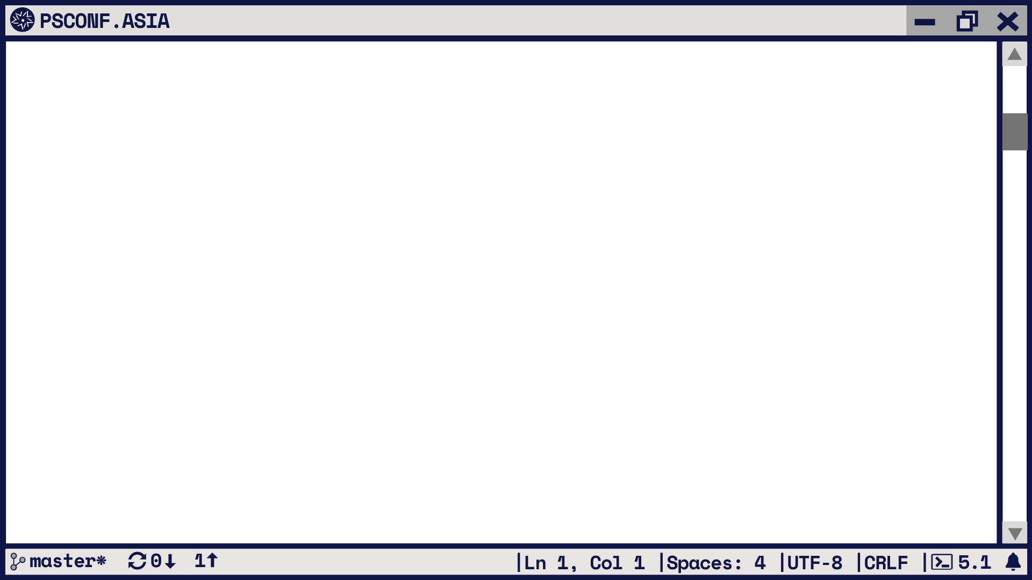
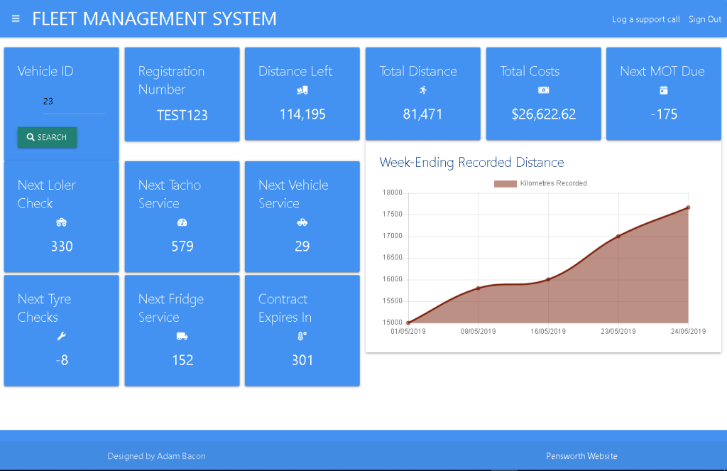
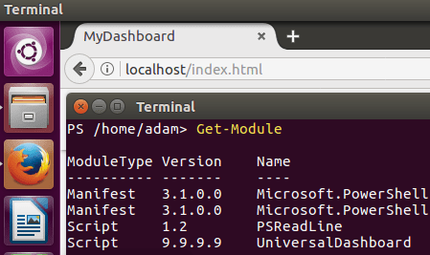
PS > What is Universal Dashboard?
Web framework for PowerShell
Cross-platform PowerShell Module

Slide 3
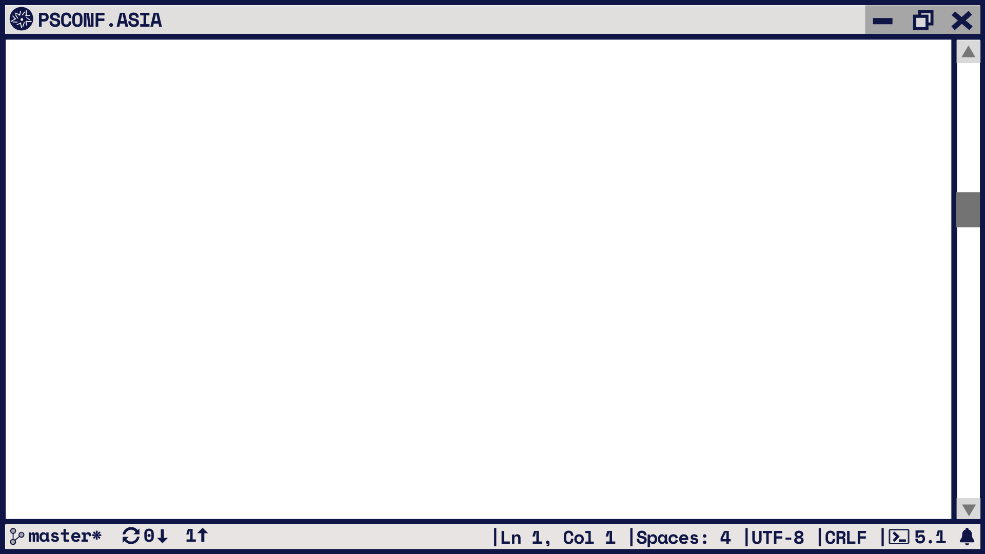
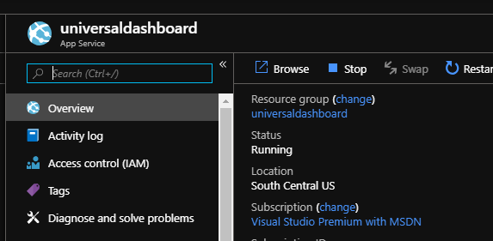
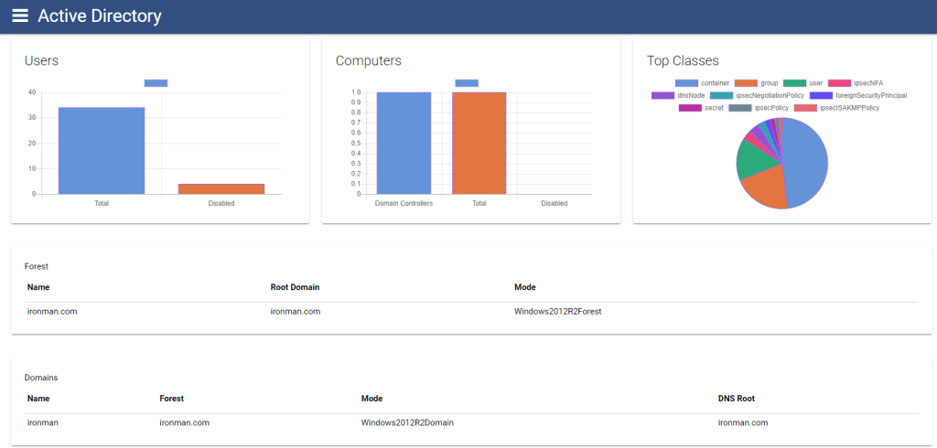
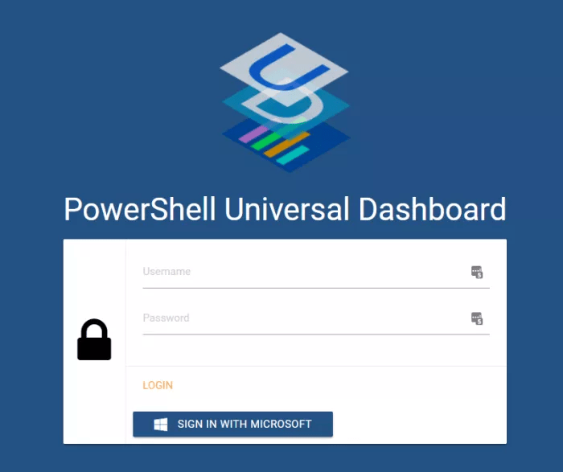
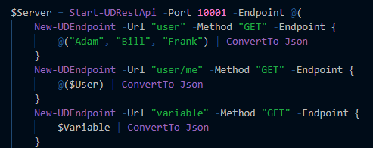
PS > What is included with Universal Dashboard?
Built-in Web Server
Dozens of Controls
REST API Support
Authentication and Authorization

Slide 4
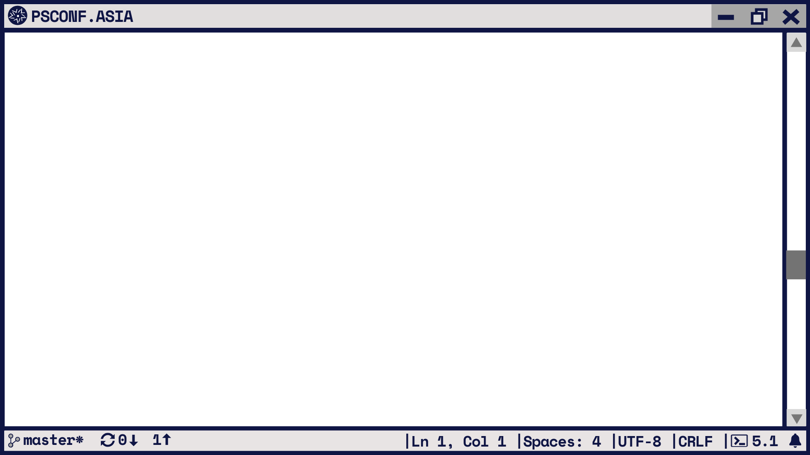




PS > What makes Universal Dashboard different?
+
=
*

Slide 5
PS > How does it work?
Execute UD PowerShell Scripts
Starts Web Server
Displays Website and Controls
Configures Web Site
Sends Web Site and Controls
Executes Script Block
Deserialize Request and Find Script Block
Requests Data
Control Loads or User Interacts
Serializes data to JSON
Renders Control or Data

Slide 6
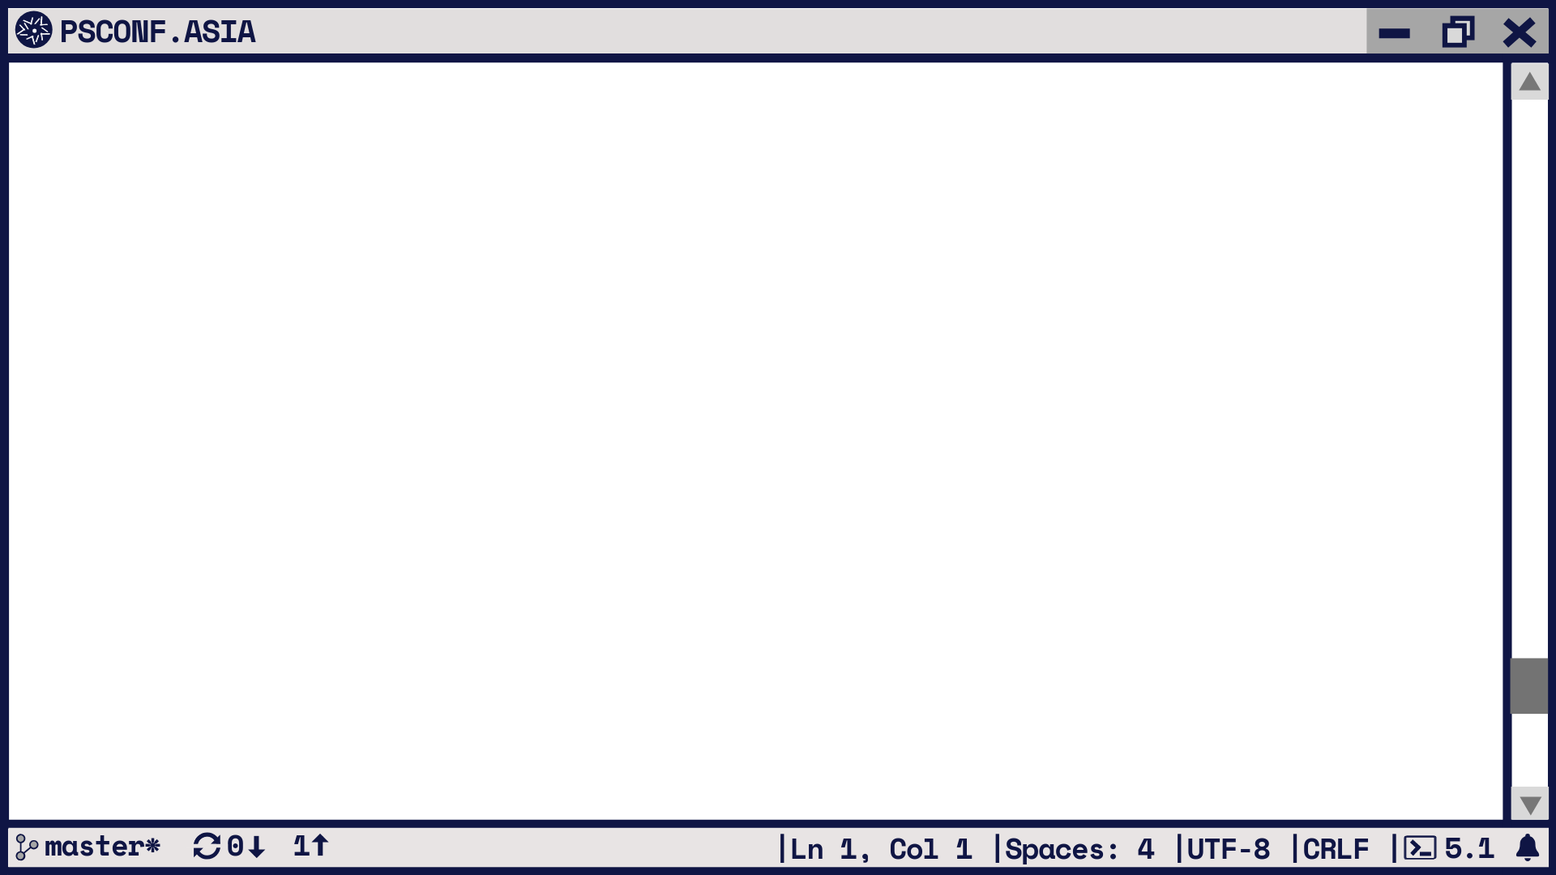
PS > .\Demo.ps1
.\demo.ps1 : The term '.\demo.ps1' is not recognized as the name of a cmdlet, function, script file, or operable
program. Check the spelling of the name, or if a path was included, verify that the path is correct and try again.
At line:1 char:1
+ .\demo.ps1
+ ~~~~~~~~~~
+ CategoryInfo : ObjectNotFound: (.\demo.ps1:String) [], CommandNotFoundException
+ FullyQualifiedErrorId : CommandNotFoundException

Slide 7
PS > .\ContactMe.ps1
Twitter - @adamdriscoll
GitHub – ironmansoftware or adamdriscoll
Forums – https://forums.universaldashboard.io
Marketplace – https://marketplace.universaldashboard.io

Slide 8
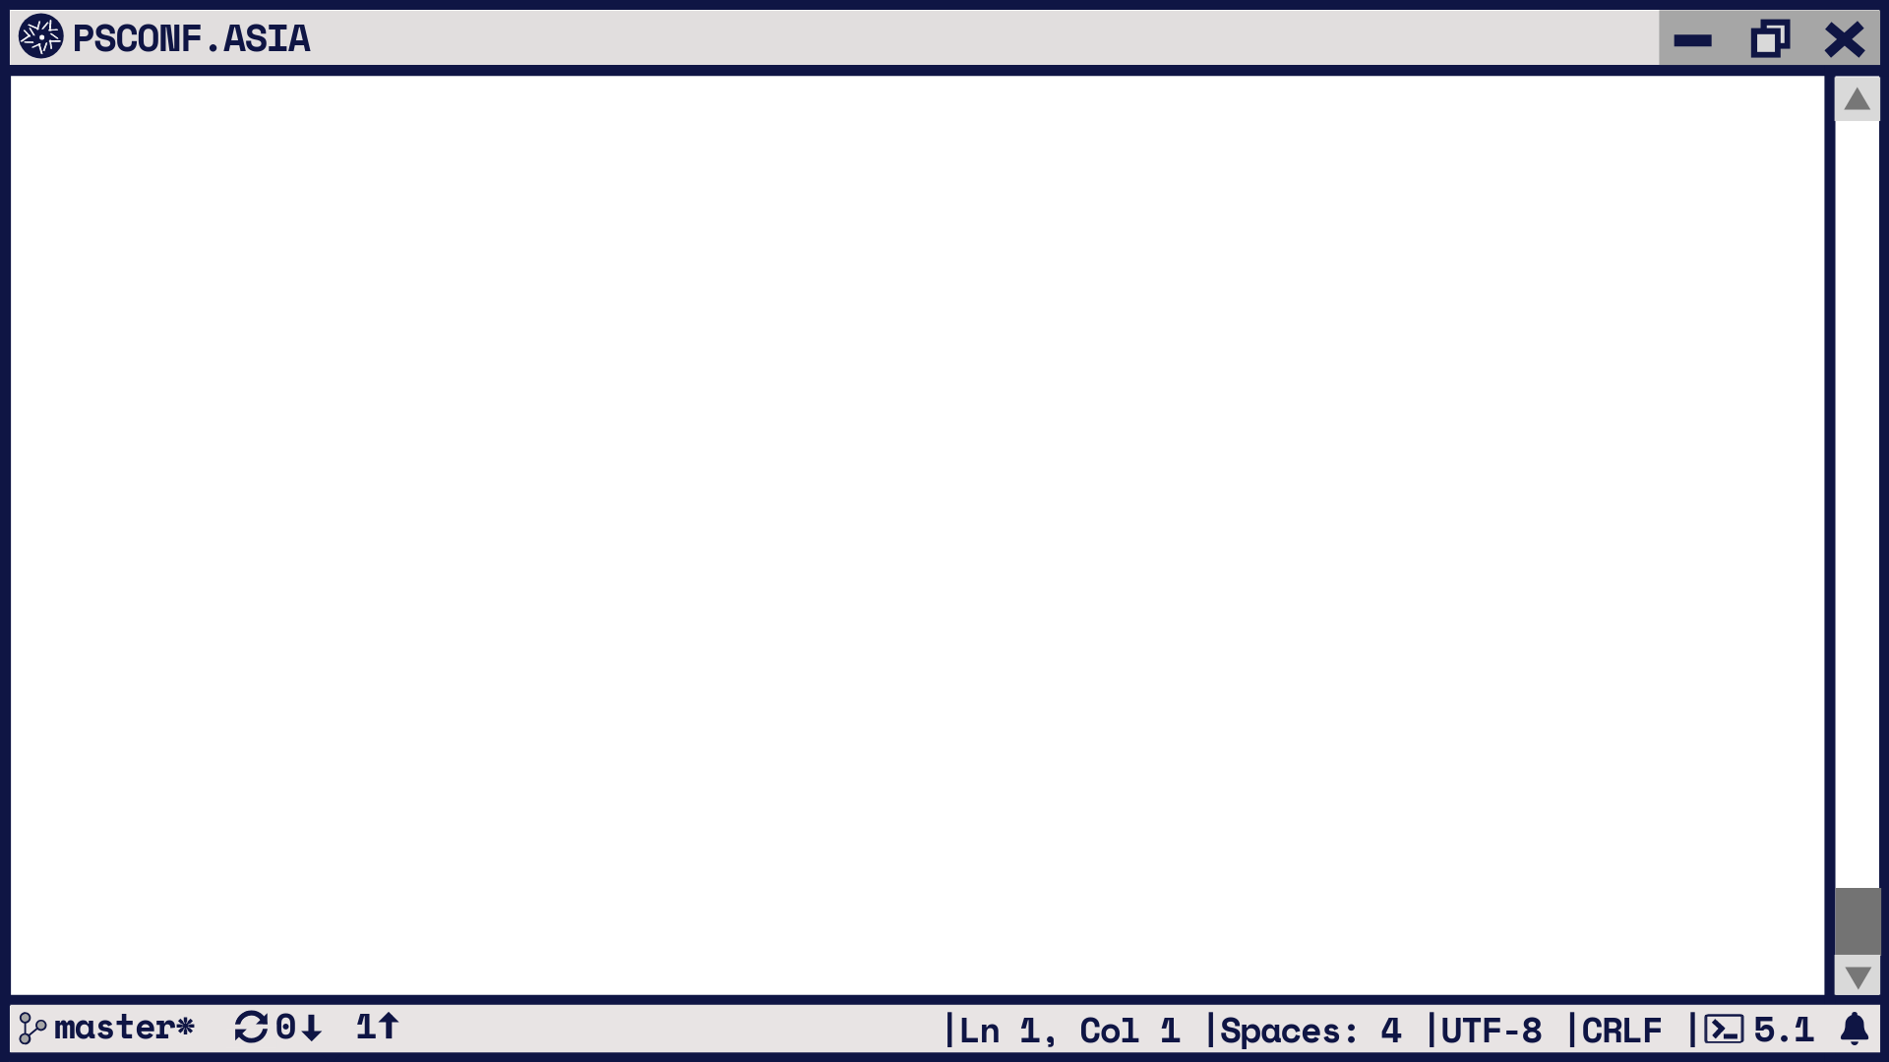
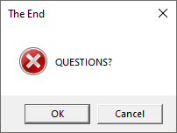

Slide 9
Rate this session on EventRaft

